Slide 1
Software Testing
Some Material adapted from Lethbridge & Laganiere;
Some Material adapted from Pressman.

Slide 2
Where are we..
Sprint 0: Prep
Sprint 1: Scoping
Sprint 2: Requirements
Sprint 3: High Level Design
Sprint 4: Scheduling & Testing / R1
Sprint 5: Detailed Design
Sprint 6: Patterns
Sprint 7: Anti Patterns / R2
Sprint 8: Finale
Jan 4
Mar 12
Mar 26
Lecture topics will follow this flow
As the projects tracks these sprints
Submissions due along the way
Guest lectures from startups and Industry leaders
EACH SPRINT IS 2 WEEKS, Friday start.
Jan 15
Feb 26
Apr 9
Jan 29
Feb 12
April 23
April 23+ EVALUATIONS

Slide 3
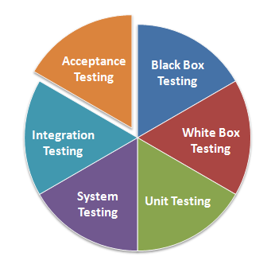
Types of testing

Slide 4
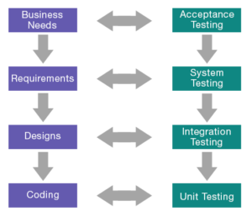
Testing, aligned with dev phases

Slide 5
Testing phases: V model
Requirements
Acceptance Testing
Architecture
System Testing
Detailed Design
Integration Testing
Implementation
Unit Testing
A lifecycle view that shows relationships between development and test phases

Slide 6
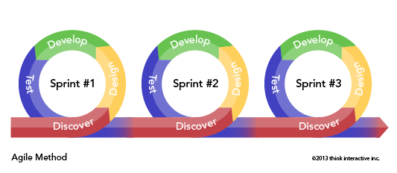
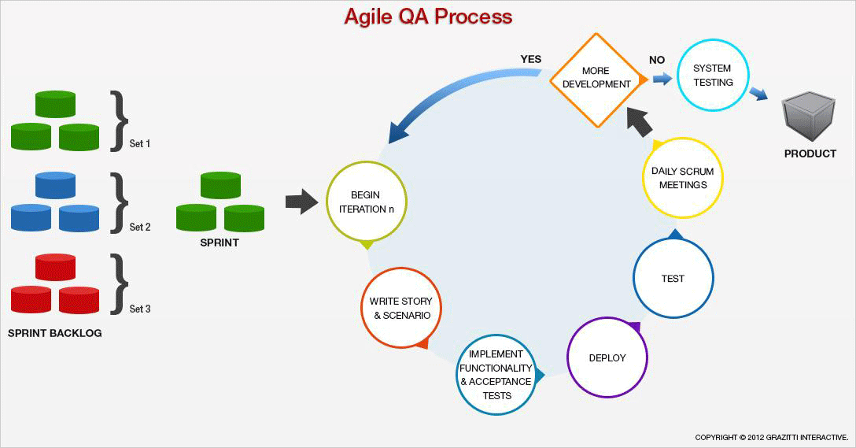
AGILE..

Slide 7
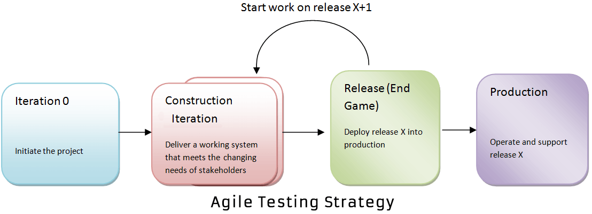
Testing in tandem with dev, in Agile

Slide 8
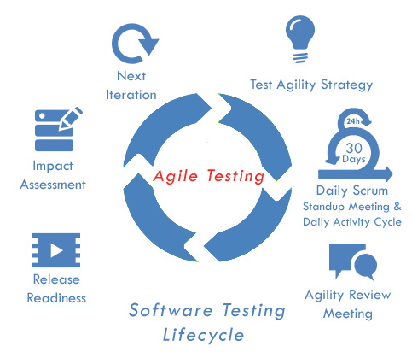
Lifecycle

Slide 9
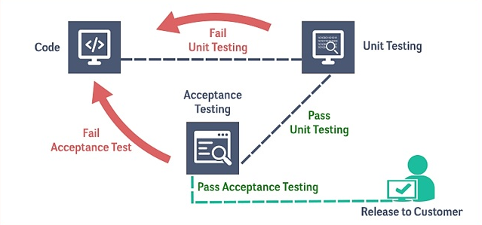
Unit Test & Acceptance test
https://www.spec-qa.com/blog/agile-testing-effective-sharp-and-accurate-test-methodology/

Slide 10
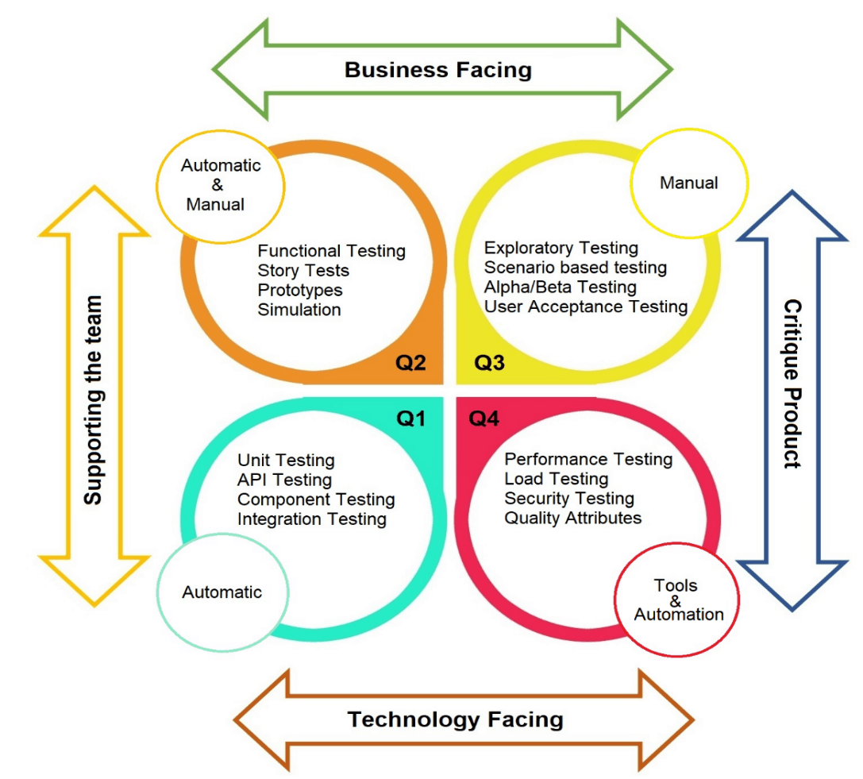
Facets of testing

Slide 11
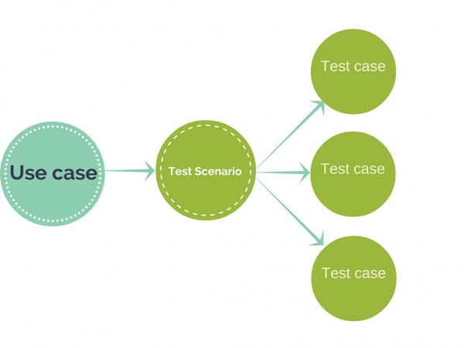
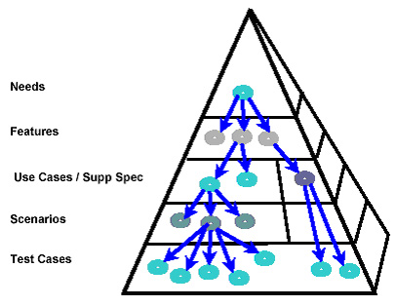
Organising tests Test Scenarios & cases

Slide 12
White-Box Testing | Black Box testing
requirements
output
... our goal is to ensure that all
input
events
statements and conditions have
been executed at least once ...

Slide 13
Testing Levels
Software products are tested at four levels:
Unit testing
Integration testing
System testing
Acceptance testing

Slide 14
Terms & Concepts

Slide 15
Testing phases: V model
Requirements
Acceptance Testing
Architecture
System Testing
Detailed Design
Integration Testing
Implementation
Unit Testing
A lifecycle view that shows relationships between development and test phases

Slide 16
Testing Phases
Unit Testing
Developer tests individual modules
Integration testing
Put modules together, try to get them working together
Integration testing is complete when the different pieces are able to work together
System testing
Testing of entire deliverable against specs
Acceptance testing
Testing against user needs, often by the user

Slide 17
Exhaustive Testing
loop < 20 X
There are 10 possible paths! If we execute one test per millisecond, it would take 3,170 years to test this program!!

Slide 18
Selective Testing
Selected path
loop < 20 X

Slide 19
Coverage
Function coverage: Each function/method executed by at least one test case
Statement coverage: Each line of code covered by at least one test case (need more test cases than above)
Path coverage: Every possible path through code covered by at least one test case (need lots of test cases)

Slide 20
Equivalence classes
It is inappropriate to test by brute force, using every possible input value
Takes a huge amount of time
Is impractical
Is pointless!
You should divide the possible inputs into groups which you believe will be treated similarly by all algorithms.
Such groups are called equivalence classes.
A tester needs only to run one test per equivalence class
The tester has to
understand the required input,
appreciate how the software may have been designed

Slide 21
Example of equivalence classes
Valid input is a month number (1-12)
Equivalence classes are: [-∞..0], [1..12], [13.. ∞]

Slide 22
Combinations of equivalence classes
Combinatorial explosion means that you cannot realistically test every possible system-wide equivalence class.
If there are 4 inputs with 5 possible values there are 5⁴ (i.e.625) possible system-wide equivalence classes.
You should first make sure that at least one test is run with every equivalence class of every individual input.
You should also test all combinations where an input is likely to affect the interpretation of another.
You should test a few other random combinations of equivalence classes.

Slide 23
Example equivalence class combinations
One valid input is either ‘Metric’ or ‘US/Imperial’
Equivalence classes are:
Metric, US/Imperial, Other
Another valid input is maximum speed: 1 to 750 km/h or 1 to 500 mph
Validity depends on whether metric or US/imperial
Equivalence classes are:
[-∞..0], [1..500], [501..750], [751.. ∞]
Some test combinations
Metric, [1..500] valid
US/Imperial, [501..750] invalid
Metric, [501..750] valid
Metric, [501..750] valid

Slide 24
Testing at boundaries of equivalence classes
More errors in software occur at the boundaries of equivalence classes
The idea of equivalence class testing should be expanded to specifically test values at the extremes of each equivalence class
E.g. The number 0 often causes problems
E.g.: If the valid input is a month number (1-12)
Test equivalence classes as before
Test 0, 1, 12 and 13 as well as very large positive and negative values

Slide 25
Test Cases

Slide 27
Test Case
A triplet of [Input, Steps, Expected behavior]
(IEEE Standard 829-1983) Documentation specifying inputs, predicted results, and a set of execution conditions for a test item.”
Purpose: to get some information about the system behavior

Slide 28
Information that can be gained from Test Cases
Find defects
A test is run in order to trigger failures that expose defects.
Assess conformance to specification.
Assess conformance to standards or regulations.
Find safe scenarios for use of the product
Assess quality
Block premature product releases.
Help managers make ship / no-ship decisions.
Minimize technical support costs.

Slide 29
Getting test cases

Slide 30
Identifying Scenarios
Use case has one basic flow (B) and 0..* alternate flows (A1..An)
Notation:
Basic flow: B
Alternative flows: A1, A2, A3, ...
Steps in a basic flow: B1, B2, B3, ...
Steps in alternative flow 1: A1.1, A1.2, A1.3, ...
Steps in alternative flow 2: A2.1, A2.2, A2.3, ...
Scenario - A possible path through basic and alternate flows that an actor can take.
Can be Usage, growth or exploratory.
Usage from use cases, mostly for functional testing
Growth and exploratory for system level testing
Notes:
A scenario is an instance of the use case.

Slide 31
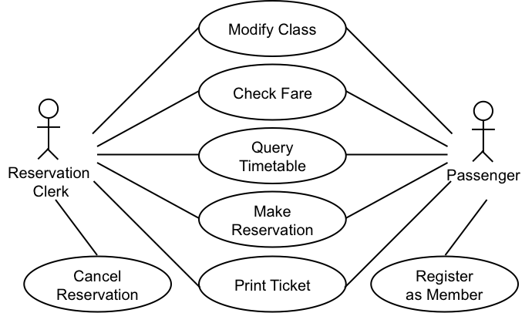
Writing test cases
Assume the simplified use case from IRCTC.co.in.

Slide 32
Make Reservation Basic Flow

Slide 33
Alternate Flows
A1 No matching trains found
A2 Source Destination require modification
A3 Session Expired
A4 Continue booking another ticket
A5 Leave in between
A6 Booking not permitted right now (time, date constraints due to business rules)
A7 Booking senior citizen ticket
A8 Changing boarding point
A9 Check availability
A10 Close transaction in between
…Many more

Slide 34
Identifying Scenarios from use cases
Should be feasible
Every basic +
alternate flows individually +
combinations of alternate flows.
Scenario 1: Basic
Scenario 2: A1
Scenario 3: A2
Scenario 4: A3
Scenario 5: A4
Scenario 6: A5
Scenario 7 A6
Scenario 8 A7
Scenario 9 A8
Scenario 10: A1, A2
Scenario 11: A3, A4
Scenario: 12 A4, A5
Scenario 13: A3, A5
Scenario 14 A6, A7
Scenario 15 A7, A8

Slide 35
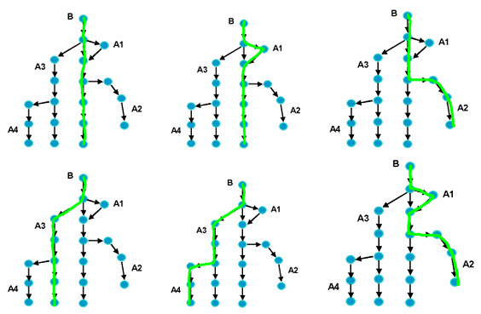
Possible Scenarios

Slide 36
Various Dimensions of Testing
Behavior
Performance
Usability
Scalability
Portability
Maintainability
Random Behavior
Security
….
Unit Testing
Module
Integration
System
Acceptance
Quality under test
Unit under test
Dimensions of Testing
Manual
Automated
Modality
Type of test
Black box
White box

Slide 37
Whitebox. Blackbox.

Slide 38
White-Box Testing
... our goal is to ensure that all
statements and conditions have
been executed at least once ...

Slide 39
White-box testing
Also called ‘glass-box’ or ‘structural’ testing
Testers have access to the system design
They can
Examine the design documents
View the code
Observe at run time the steps taken by algorithms and their internal data
Individual programmers often informally employ glass-box testing to verify their own code

Slide 40
White Box Methods
Can be applied at all levels of system development – unit, integration, and system
Coverage (Control flow)
statement
branch
Dataflow
Mutation

Slide 41
Statement Coverage
Execute each statement in the program
Considered minimum criterion for most unit testing
May be difficult to achieve for error cases

Slide 42
Example Program
Statement tests
a = 3, b = 4
executes 1, 3, 4, 5, 6, 7, 5, 6, 7, 5, 6, 7, 5, 8
a = -3, b = 2
executes 1, 2
1: if (a < 0) {
2: return 0 }
3: r = 0;
4: c = a;
5: while (c > 0) {
6: r = r + b;
7: c = c - 1; }
8: return r;

Slide 43
Branch Coverage
Execute each branch of the program at least once
Differs from statement coverage only for "if" statements without "else"s and case statements without default cases.

Slide 44
Structured Testing
Selected path
loop < 20 X

Slide 45
Basis Path Testing
1
Next, we derive the
independent paths:
2
Since V(G) = 4,
there are four paths
3
Path 1: 1,2,3,6,7,8
4
Path 2: 1,2,3,5,7,8
5
6
Path 3: 1,2,4,7,8
Path 4: 1,2,4,7,2..,8
Finally, we derive test
7
cases to exercise these
paths.
8

Slide 46
Basis Path Testing
First, we compute the McCabe’s cyclomatic complexity:
number of simple decisions + 1
or
number of enclosed areas + 1
In this case, V(G) = 4
If decisions are not binary, this can’t be used for computation of cyclomatic complexity

Slide 47
Cyclomatic complexity
Cyclomatic complexity of a graph is
C = edges – nodes + 2
A
B
C
C
D
E
F
G

Slide 48
Why Data flow testing?
Look at this simple C program
#include <stdio.h>
main() {
int x;
printf (“%d”,x);
}
What value for x will be printed ?

Slide 49
Dataflow Testing
Definitions and Uses
Defining node
input statement
lhs of assignment
Usage node
output statement
rhs of assignment
control statement
DU testing: execute each du-path of each variable

Slide 50
Example Program
1: r = 0;
2: c = a;
3: while (c > 0) {
4: r = r + b;
5: c = c - 1; }
6: return r;
Def (c) = {2, 5} Use (c) = {3, 5}
Def (r) = {1, 4} Use (r) = {4, 6}

Slide 51
Black-Box Testing
requirements
output
input
events

Slide 52
Testing Levels

Slide 53
Testing
Software products are tested at four levels:
Unit testing
Integration testing
System testing
Acceptance testing

Slide 54
Unit testing
During unit testing, modules are tested in isolation:
If all modules were to be tested together:
it may not be easy to determine which module has the error.
Unit testing reduces debugging effort several folds.
Programmers carry out unit testing immediately after they complete the coding of a module.

Slide 55
Role of Unit Testing
Assure minimum quality of units before integration into system
Focus attention on relatively small units
Testing forces us to read our own code – spend more time reading than writing
Automated tests support maintainability and extendibility
Marks end of development step

Slide 56
Integration testing
After different modules of a system have been coded and unit tested:
modules are integrated in steps according to an integration plan
partially integrated system is tested at each integration step.
Objectives:
Gain confidence in the integrity of overall system design
Ensure proper interaction of components
Run simple system-level tests

Slide 57
Integration Testing Strategies
Big-bang
Top-down
Bottom-up
Critical-first
Function-at-a-time
As-delivered
Sandwich

Slide 58
Big Bang Integration Testing
Big bang approach is the simplest integration testing approach:
all the modules are simply put together and tested.
this technique is used only for very small systems.
Issues:
avoids cost of scaffolding (stubs or drivers)
does not provide any locality for finding faults

Slide 59
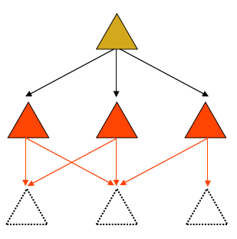
Top-down integration testing
Start with top-level modules
Use stubs for lower-level modules
As each level is completed, replace
stubs with next level of modules
Pros:
Always have a top-level system
Stubs can be written from interface specifications
Cons:
May delay performance problems until too late
Stubs can be expensive

Slide 60
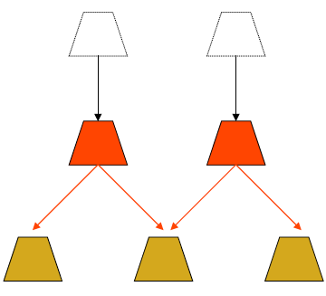
Bottom-up Integration Testing
Start with bottom-level modules
Use drivers for upper-level modules
As each level is completed, replace drivers with next level of modules
Pros:
Primitive functions get most testing
Drivers are usually cheap
Cons:
Only have a complete system at the end

Slide 61
Critical-first Integration
Integrate the most critical components first
Add the remaining pieces later
Issues:
Guarantees that the most important components work
May be difficult to integrate

Slide 62
Function-at-a-time Integration
Integrate all modules needed to perform a particular function
For each function, add another set of modules
Issues
Makes for easier test generation
May postpone function interaction for too long
Dependencies may create a problem

Slide 63
As-Delivered Integration
Integrate the modules as and when they become available
Issues
Efficient – Just-in-time Integration
Lazy – may lead to missed schedules

Slide 64
Sandwich Integration Testing
Mixed (or sandwiched) integration testing:
uses both top-down and bottom-up testing approaches.
Most common approach

Slide 65
Example of different integration strategies

Slide 66
System Testing
Objectives
Gain confidence in the integrity of the system as a whole
Ensure compliance with functional requirements
Ensure compliance with performance requirements

Slide 67
Testing Functional Requirements
1. Prepare a test plan from the functional specification of the system
2. Prepare tests for all areas of functionality
3. Review test plan and tests
4. Execute tests
5. Monitor fault rate

Slide 68
Testing Performance Requirements
1. Identify stress points of system
2. Create or obtain load generators
might use existing system
might buy/make special purpose tools
3. Run stress tests
4. Monitor system performance
usually needs instrumentation

Slide 69
Acceptance Testing
Testing performed by the customer or end-user himself:
to determine whether the system should be accepted or rejected.
Other paths to acceptance:
Beta testing
Distribute system to volunteers
Collect change requests, fix, redistribute
Collect statistics on beta use
Shadowing
Collect or redistribute real-time use of existing system
Compare results
Collect statistics

Slide 70
Test driven Dev & Limits

Slide 71
Test Driven Development
Write some tests before writing the code
focuses effort
clarifies requirements
Run the tests after every code modification
Feedback from successful tests
good for developer
good for customer

Slide 72
Limits of Testing
Testing can never demonstrate the absence of errors
Exhaustive testing is infeasible
Testing may be done imperfectly
Consider the following example:
int testExample (int j) {
j = j - 1;
j = j/30000;
return j;
}
DO YOU SEE A PROBLEM?

Slide 73
Limits of Testing (contd…)
int testExample (int j) {
j = j - 1; // this is supposed to be j = j + 1
j = j/30000;
return j;
}
There are 65,536 test cases.
Input (j) | Expected Result | Actual Result
1 | 0 | 0
42 | 0 | 0
40000 | 1 | 1
-64000 | -2 | -2

Slide 74
The test-fix-test cycle
When a failure occurs during testing:
Each failure report is entered into a failure tracking system.
It is then screened and assigned a priority.
Low-priority failures might be put on a known bugs list that is included with the software’s release notes.
Some failure reports might be merged if they appear to result from the same defects.
Somebody is assigned to investigate a failure.
That person tracks down the defect and fixes it.
Finally a new version of the system is created, ready to be tested again.

Slide 75
Deciding when to stop testing
All of the level 1 (“critical”) test cases must have been successfully executed.
Certain pre-defined percentages of level 2 and level 3 test cases must have been executed successfully.
The targets must have been achieved and are maintained for at least two cycles of ‘builds’.
A build involves compiling and integrating all the components.
Failure rates can fluctuate from build to build as:
Different sets of regression tests are run.
New defects are introduced.

Slide 76
People. And PLanning

Slide 77
The roles of people involved in testing
The first pass of unit and integration testing is called developer testing.
Preliminary testing performed by the software developers who do the design.
Independent testing may be performed by separate group.
They do not have a vested interest in seeing as many test cases pass as possible.
They develop specific expertise in how to do good testing, and how to use testing tools.

Slide 78
Test planning
Decide on overall test strategy
What type of integration
Whether to automate system tests
Whether there is an independent test team
Decide on the coverage strategy for system tests
Compute the number of test cases needed
Identify the test cases and implement them
The set of test cases constitutes a “test suite”
May categorize into critical, important, optional tests (level 1, 2, 3)
Identify a subset of the tests as regression tests

Slide 79
Testing performed by users and clients
Alpha testing
Performed by the user or client, but under the supervision of the software development team.
Beta testing
Performed by the user or client in a normal work environment.
Recruited from the potential user population.
An open beta release is the release of low-quality software to the general population.
Acceptance testing
Performed by users and customers.
However, the customers do it on their own initiative.

Slide 80
Inspections Vs Testing
Both testing and inspection rely on different aspects of human intelligence.
Testing can find defects whose consequences are obvious but which are buried in complex code.
Inspecting can find defects that relate to maintainability or efficiency.
The chances of mistakes are reduced if both activities are performed.

Slide 81
Testing or inspecting, which comes first?
It is important to inspect software before extensively testing it.
The reason for this is that inspecting allows you to quickly get rid of many defects.
Even before developer testing

Slide 82
